Slide 1
Prezentace z kurzu Uso didáctico del Cine en el Aula
Červen 2018 Madrid

Slide 2
Multiple Intelligences test: https://www.edutopia.org/multiple-intelligences-assessment
Verbal-linguistic intelligence refers to an individual's ability to analyze information and produce work that involves oral and written language, such as speeches, books, and emails.
Logical-mathematical intelligence describes the ability to develop equations and proofs, make calculations, and solve abstract problems.
Visual-spatial intelligence allows people to comprehend maps and other types of graphical information.
Musical intelligence enables individuals to produce and make meaning of different types of sound.
Naturalistic intelligence refers to the ability to identify and distinguish among different types of plants, animals, and weather formations found in the natural world.
Bodily-kinesthetic intelligence entails using one's own body to create products or solve problems.
Interpersonal intelligence reflects an ability to recognize and understand other people's moods, desires, motivations, and intentions.
Intrapersonal intelligence refers to people's ability to recognize and assess those same characteristics within themselves.

Slide 3
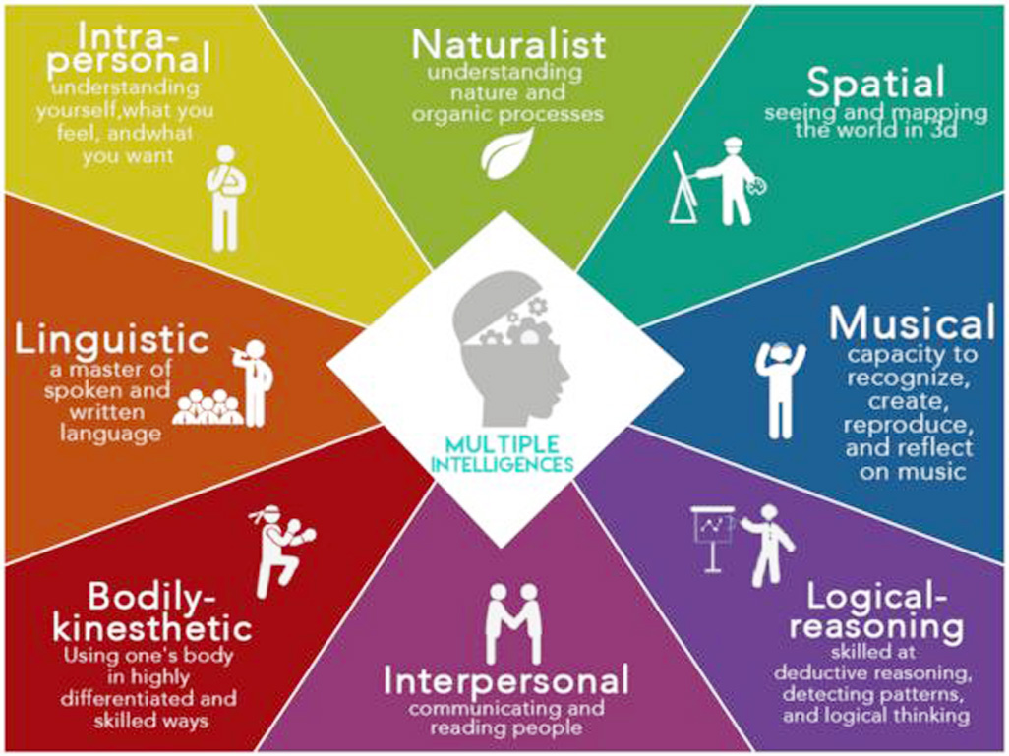

Slide 4
https://www.youtube.com/watch?v=nt5wPIhhDDU

Slide 5
The New Media Literacies http://www.newmedialiteracies.org/the-literacies/

Slide 6
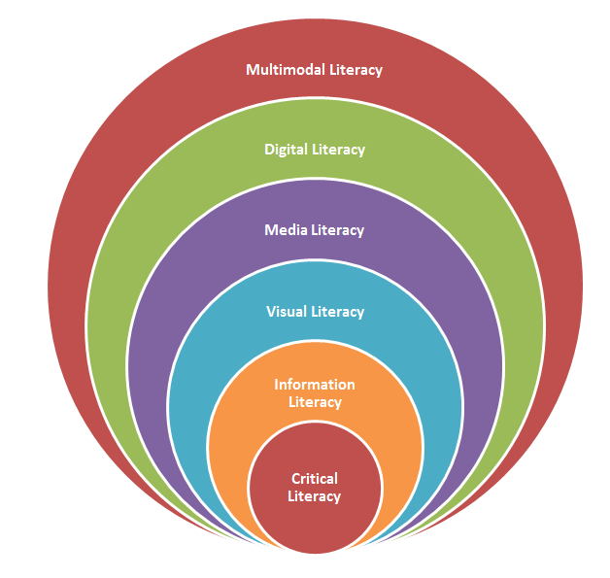

Slide 8
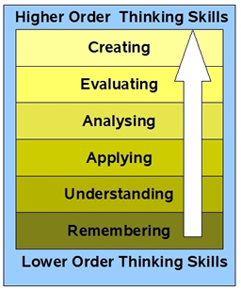

Slide 9
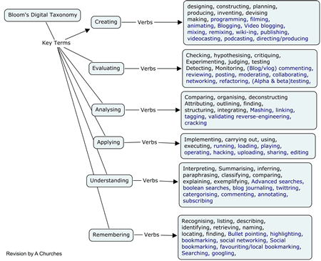

Slide 10
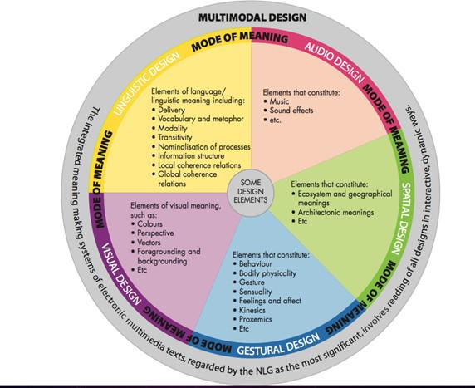

Slide 11
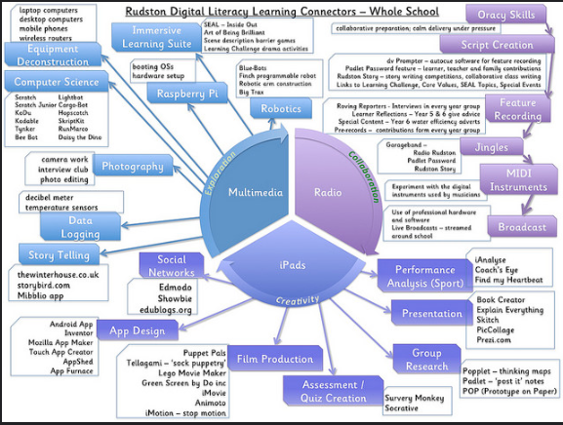
https://www.flickr.com/photos/136638084@N03/25755134116

Slide 12
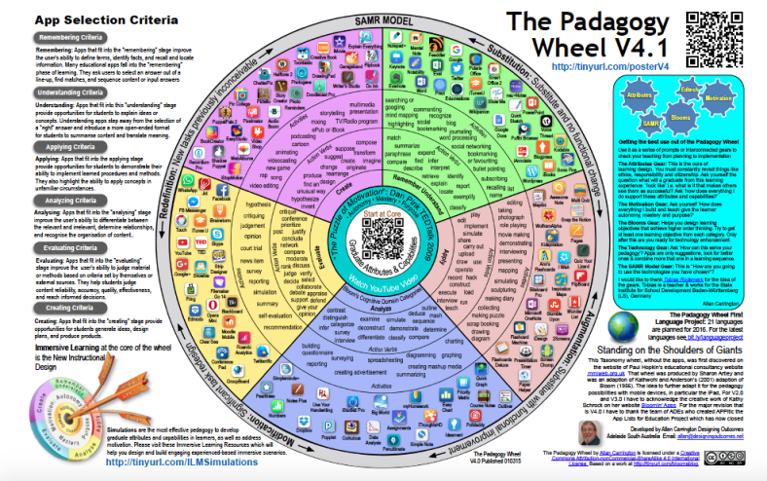
https://designingoutcomes.com/assets/PadWheelV4/PadWheel_Poster_V4_HighRez.pdf

Slide 13
How to organize your lesson
Title / Type of video / Duration
Level
Objectives: language (grammar, vocabulary, pronunciation) / communication/ cultural / intercultural
Type of skills – Multiple Intelligencies
ACTIVITIES:
Warm-up
Pre-task (before watching)
Task (while watching)
Post-task (after watching)

Slide 14
How to evaluate
objectives
presentation (formal/oral)
creativity
justification /explanation

Slide 15
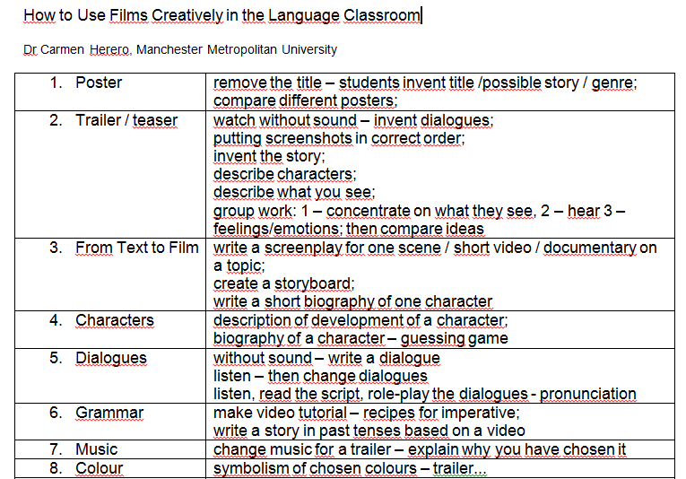

Slide 16
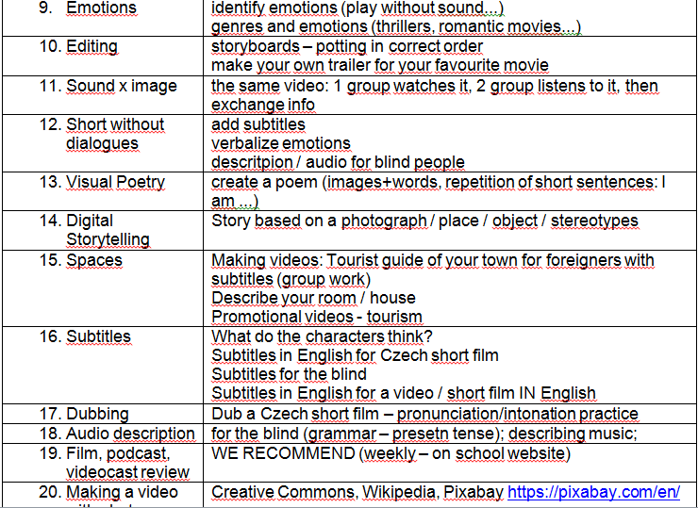

Slide 17
Video Resources
http://film-english.com/
https://allatc.wordpress.com/
http://www.bombay-tv.net/
https://www.bfi.org.uk/education-research/education/education-resources
https://vimeo.com/channels/staffpicks
https://vimeo.com/
https://www.youtube.com/futureshorts
https://www.shortoftheweek.com
http://www.cc.com/short-form
https://www.studentfilms.com/showcase/
https://www.thefilmnetwork.co.uk/films
http://www.filta.org.uk/
https://www2.mmu.ac.uk/languages/flame/
https://ed.ted.com/
https://www.ted.com/watch/ted-ed
https://www.nytimes.com/column/learning-film-club?action=click&contentCollection=The%20Learning%20Network&module=ExtendedByline&region=Header&pgtype=article
https://www.nytimes.com/2017/03/15/learning/lesson-plans/25-mini-films-for-exploring-race-bias-and-identity-with-students.html

Slide 18
Useful links
https://www.wevideo.com/ subtitles
https://dotsub.com/
https://www.clipconverter.cc/
https://quizlet.com/en-gb
https://edpuzzle.com/ create questions to videos
https://www.powtoon.com/home/ create videos
https://wordpress.com
http://edutechwiki.unige.ch/en/List_of_web_2.0_applications
https://www.nchsoftware.com/videopad/index.html
https://www.audacityteam.org/
https://cz.pinterest.com/
http://pixabay.com/en/ free pictures

Slide 19
How to download video from youtube
https://www.youtube.com/watch?v=vthprBSZEfQ
https://www.youtube.com/watch?v=HYSnhj1h210
https://www.youtube.com/watch?v=5qEbkZkYf4I

