Slide 1



INTERNET SAFETY GUIDE

Slide 2
Content table
Introduction
Discrimination
Tips for Preventing Discrimination
Cyberbullying
Stereotypes
Algorithm-driven Media Services
Media Ethics
Digital identity
Slide 3
Slide 6
Slide 9
Slide 11
Slide 15
Slide 19
Slide 28
Slide 34

Slide 3
introduction

Slide 4
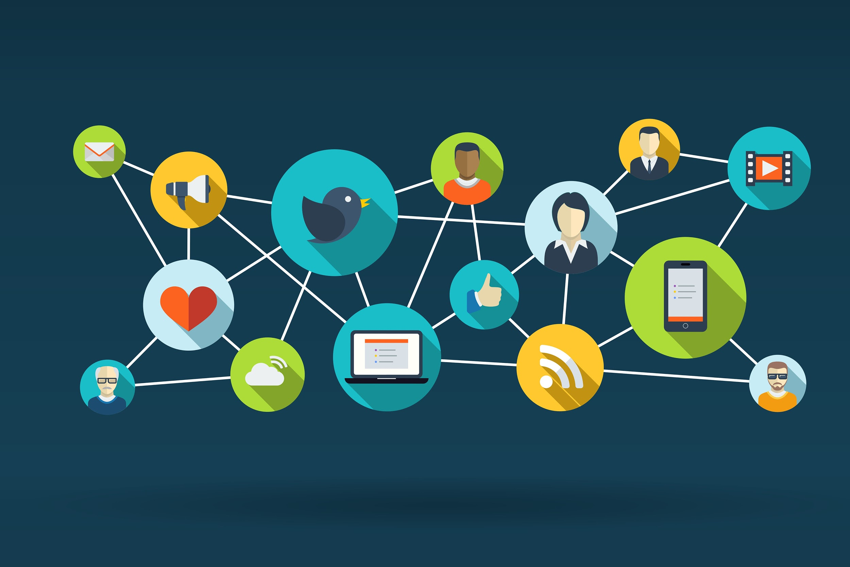
We are lucky enough to have been born in an era in which information and education is no longer a problem for many people around the globe. We have this massive platform containing all the knowledge in the world, but, in order to be able to use it to its full extent and potential, we have to make sure we are safe, comfortable, and that we are using the information at hand ethically while surfacing on the Internet.

Slide 5
We can all agree that the Internet is not always a safe place, especially for teenagers. Cyberbullying, hate speech and discrimination are some of the main problems we may face while navigating on the Internet, and these represent just the tip of the iceberg. Because this platform is so vast, it is very hard to filtrate all the information at hand, and some things that might be harmful to us are due to slip in.
Hatespeech
problems
Cyberbullying
Discrimination

Slide 6
discrimination

Slide 7
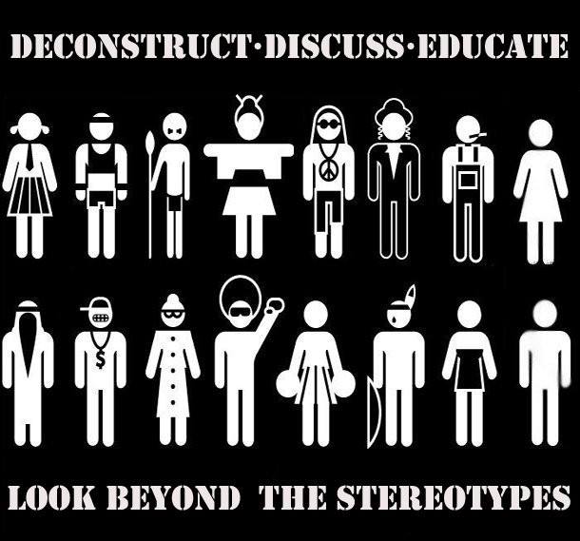
Discrimination is an action of recognising the differences between us and other people and injustice
regarding some people who belong to a social group.

Slide 8
Discrimination is a worldwide problem, meaning that it can be practiced everywhere, starting from children to the old people. This action starts when a person notices the differences of a man, visible or not at first sight, wanting to grow their self-esteem by seeing the other person with a lower self-esteem than theirs. Some of the causes that start the discrimination are stereotypes and cultural stereotypes because a lot of people have some beliefs or expectations about social groups.
The ways of practicing this action depend on the type of discrimination, some of them being:
ignorance or exclusion from society
verbal abuse
physical abuse
cyberbullying

Slide 9
Tips for preventing discrimination

Slide 10
STOP JUDGING.
A human can’t have the same pattern as another, so it is normal to be different.
SEEK FOR HELP.
If you are discriminated, don’t be afraid to protect yourself from the judgers or to talk to other people that might help you
HELP OTHERS AROUND YOU.
If you know or see someone who is discriminated, don’t turn their backs to them if they ask for help. Be that different person, pay attention to them and help them.
LOVE YOURSELF.
Yes, you might be different. But this difference is in a good way because this trait makes you who you are. Maybe you can’t love yourself for now, but at least rely on those people that admire and love you for who you are.

Slide 11
cyberbullying

Slide 12
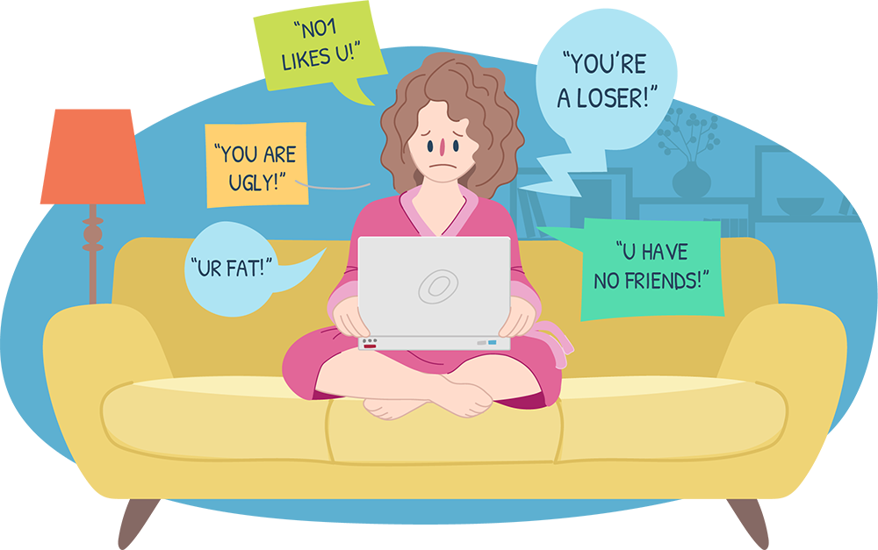
forms of cyberbulling
Reciving malicious messages from known or unknown persons or threatening, offensive messages through social networks, such as Facebook or Instagram.
Sending pictures or videos with you in order to offend or make you feel embarrassed.
Spreading rumors about you through SMS or chat applications.
Stealing your passwords to take over your accounts.
Creating a fake profile with your pictures.

Slide 13
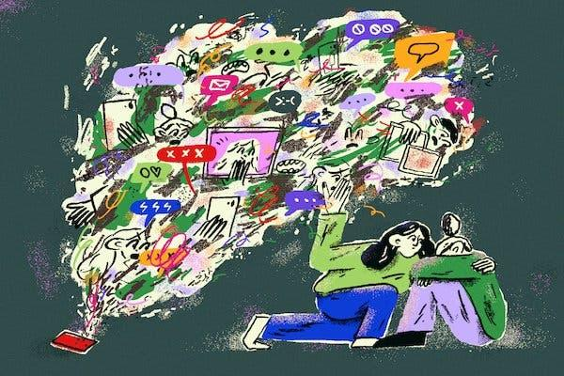
How it affects us?
The person can feel trapped in a situation
without escape.
The person can feel alone or excluded.
Mental illnesses, like anxiety or depression
can appear.
Anger, sadness, stress

Slide 14
what can we do about it?
• Do not post personal information such as your address or phone number.
• Be careful what kind of photos you post or share.
• Keep your passwords just for you.
• Do not respond to the bully. It will encourage him to continue.
• Report and block the person who bothers you.
A
D
D
R
E
S
S
R E P O R T B L O C K
P
H
O
T
O
S

Slide 15
stereotypes

Slide 16
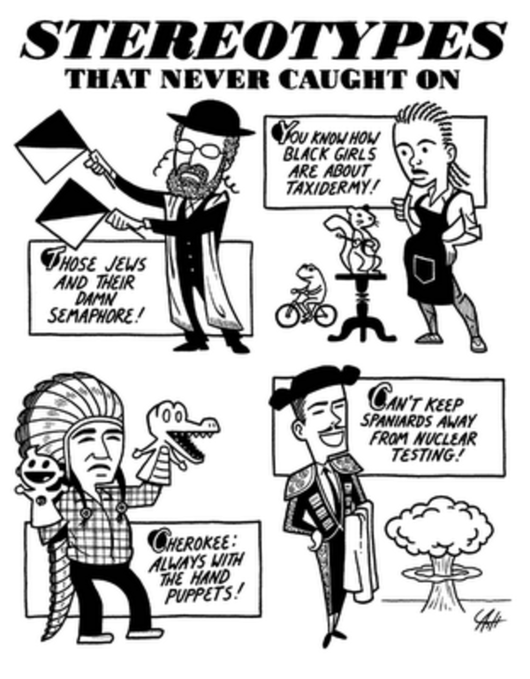
We are sure each one of you was ever thought to be part of a specific group or thought the same thing about someone else, but what does it mean to have a befief about somene before you get to know him?
Stereotypes are an over-generalized belief about a category of people that are expected to do a specific action or to have a particular behavior based on a group they belong to.

Slide 17
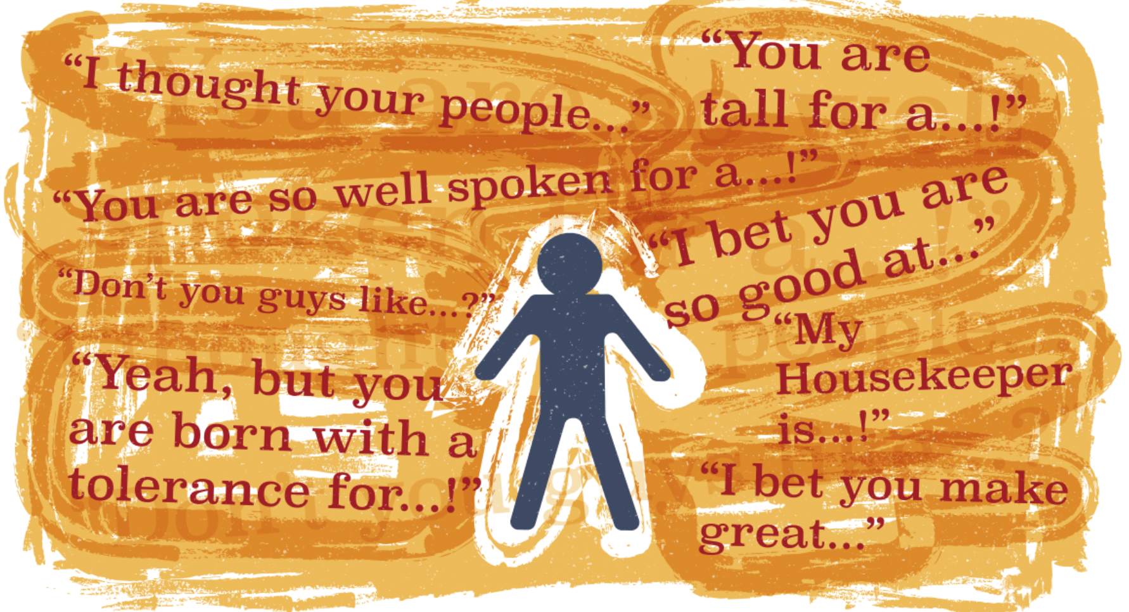
We are usually stereotiping because it is easier to see a person you just met as a part of a group with particular caracteristics then as a singular person. Stereotypes are used sometimes for justifying a group’s actions or atitudes or for explaining a social event. It is usually said thet stereotypes has a seed of truth in them and this is why they became so popular over centuries and why we are still using them.

Slide 18
Another explanation for why stereotypes are shared is that they are the result of a common environment that stimulates people to react in the same way. The problem with the common environment is that people do not always realise that what they say can cause problems.
We can prevent stereotypes in the same way as discrimination because stereotypes are a cause of discrimination.

Slide 19
Algorithm-driven Media Services

Slide 20
Basic Knowledge
Algorithms: Computable functions that can be implemented on computer systems. Machine learning algorithms can also update their behaviour in response to experience (input data) and performance metrics.
Bots: Computer algorithm that automatically produces content and interacts with humans on social media

Slide 21

A newer concept of algorithms sees them as not only a computable function, but also as one that updates its behaviour in response to experience (input data) and performance metrics (ibid). This process is sometimes called ‘machine learning’, where after a series of initial inputs the algorithm changes itself depending on new data.

Slide 22

It is this second type of algorithm that is increasingly being used by search engines, like Google, social media platforms, such as Facebook and more recently Twitter or Netflix, which use user preferences to personalise their services. Media platforms, such as Facebook, Google, Amazon and Twitter, personalise content and act as gatekeepers to information to a wide range of users, continually building their profiles based on account information and behavioural data derived from interactions with these platforms.

Slide 23
Types of algorithms
Matching services use algorithms to align consumers with the services they need, with the platform taking a cut of the service value or taking direct subscription fees from users. Examples include:
●recommendation systems analyse users' preferences (user profiles, website visits, demographic details, etc.) to investigate their interests and offer them recommendations (books, films, people, etc.);
●supply-demand systems link people offering a product or service to those in need of them; they can also be used to determine and personalize prices depending on some factors and ratios;

Slide 24
●advertising-driven services base their business model primarily on their ability to target advertisements at users or groups of users in a very effective way (using location, search history and more). For example, content aggregators select and personalise a continuous stream of content presented to users, which may be customised in line with the preferences of the user;
●user profiling is a common practice which consists of the gathering and analysis of user data in order to build a user profile. This may include analysis of the preferences and behaviours of other users who have similar profiles;
The excessive use of algorithms leads to what's called a “Filter Bubble“ or ”Echo Chamber” : showing someone only what they'd like to see instead of showing them a universal search result when entering a given query.

Slide 25
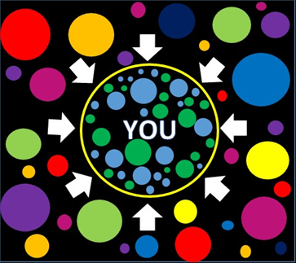
The effects of these phenomena on the world are easily observable, from watching the same types of videos on Youtube to the creation of a very strong political bias. In short, these robots can control the very way we look at life and society, and such can have an unimaginably strong impact on our lives, and the lives of everyone around us because they fail to provide us with the entire context of a situation and show us only the side we want to see, and hide the rest as if it never even existed - creating our own personal, perfect reality in which everyone agrees with us, and people online post only about our interests, etc.

Slide 26
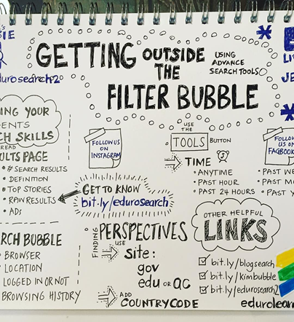

What can we do?
Ways to minimize the effects of Echo Chambers:
●Using various tools that do things such as bringing you more diverse content or letting you compare your search results with the results of others: Bobble - browser add-on, Balancer - tool, Newscube - tool, etc.
Increasing transparency and awareness of how algorithm-driven media services work.

Slide 27
●Fact-checking or countering biased or misleading information-some great websites for doing this are: Snopes.com, MBFC News, FactCheck.org, etc.
●A more critical step to take is to regularly search for opposing views, as this will definitely help see through your bubble.
Although these algorithms work behind the scenes they are a true menace, and their effects can be easily noticed, as they influence the world without us even noticing. It would seem that overthrowing something so deeply rooted in today’s society is almost impossible, but it isn’t. We have what it takes to make the change, to stop living in our little perfect bubbles and take action. By being wise and inventive, informed and responsible, by being true digital citizens, we can change the internet for the better.
Here are 5 tips to become a better digital citizen: https://www.youtube.com/watch?v=aCEKvSCDrGA

Slide 28
media ethics

Slide 29
Copyright
As its definition stands, copyright refers to the legal right of the owner of intellectual property. In much simpler terms, copyright is the right to copy. This means that the original creators of products and anyone they give authorization to are the ones with exclusive right to reproduce the work.

Slide 30
Understanding Copyright
Whenever someone creates a product that requires an amount of intellectual work it becomes intellectual property that must be protected from unauthorized duplication. A work is considered original if the author created it without any source of inspiration and just by independent thinking. This type of work is known as Original Work of Authorship.

Slide 31
Copyright Law on the Internet
Although many people recognize the Internet as a very easy way to access source of information, entertainment and communication, it also represents the largest threat to copyright. Internet copyright laws give the original authors the right to exclude others from copying their work without any permission of their own.
Copyright protection is important, because those who spend countless hours creating their intellectual work can be exploited by anyone that wants to steal their information and use it as a way to gain recognition over them. This is unfair for those who originally created the work and protecting them is vital as it is a way to encourage and motivate creators to find and express new ideas.

Slide 32

Hate Speech
Why we shouldn’t do that?
We have to understand the power of words. While some people take mean comments with less seriousness than most, others are really hurt by these words and can often end up with serious anxiety and self-hatred related problems as a result of being ridiculed or sworn at.

Slide 33

Last but not least, people have different tastes and opinions. Just because you can’t agree on something with someone doesn’t mean you have to completely dismiss them as a person. Learn to look past your differences.

Slide 34
digital identity

Slide 35

Definition
Your digital identity is the collection of information about you that exists in digital form. The information that composes your digital identity is not limited to personal aspects about yourself but it also refers to your online activities. Much simpler, a digital identity refers to everything you own, do and share in the digital world.

Slide 36

Identity theft
The main danger to which your digital identity can be exposed is represented by identity theft. Identity theft happens when someone steals your personal information and use it without authorization.
Holding your personal information, a thief could:
-Access your financial accounts
-Withdraw money or make unauthorized purchases
-File a fraudulent tax return
-Use your insurance information to receive medical care
-Create new social security cards
-Sell your information to others

Slide 37
How identity theft happens?
Criminals are trying to steal your personal data everywhere, online and offline so you should understand how they grab your information and how to protect yourself from identity theft.
Here are some of the most common ways in which identity thieves steal your data:
-Data breaches – it happens when someone gains access to an organization's data without authorization
-Malware or Spyware activity
-Credit card theft – one of the simplest forms of identity theft
-Phishing and spam messages

Slide 38

What could make your digital identity vulnerable?
It is possible for someone to compromise your security and privacy. They can also be compromised by you without realizing when you do not pay attention to what you do and what you share on the internet.
Here are some actions that may increase your digital identity’s vulnerability:
-Using public charging stations and Wi-Fi networks
-Shopping on unsecured websites
-Sharing your location/ geotagged photos
-Accepting privacy policies without reading
them carefully

Slide 39
How do you know if someone stole your information?
It is essential to know if your information has been stolen so you can quickly take action to minimize the damage. There are certain clues that could indicate if you’re a victim of identity theft:
-You don’t receive bills or mails
-You get statements for credit cards you didn’t sign up for
-You have unauthorized bank transactions or withdraws
-You see unfamiliar accounts or charges on your credit report
-You have been noticed that your personal information was accessed in a data breach
-You receive a bill or explanation of benefits for health care that you didn’t seek

Slide 40
What to do if you’re a victim?
If you recently discovered that someone stole your information, reacting quickly is the most important thing you can do. Here are the steps you can follow if you’re a victim of identity theft:
-Change your passwords
-Contact the business where your information was misused, explain that there was fraudulent information on your account and close them
-File a police report
-Consider a credit freeze to ensure no one can use your credit to open new accounts

Slide 41
Thank you for your attention!
Remember: Be a wise, inventive and responsible digital citizen and stay safe on the internet!
This is our farewell message: https://www.facebook.com/2246992295515694/videos/533355284133067/https://www.facebook.com/2246992295515694/videos/533355284133067/
Our project’s website: http://wisaerasmus.org/

Slide 42
This Presentation was made by students of the “Spiru Haret” Dobrujan high-school:
Costache Denisa-Maria; Kereszturi Adrian-Cristian;
Radu Buturugă; Stan Petruț; Gheorghe Mihai-Andrei;
Dragon Octavian Teodor; Mocanu Daniel; Neculai Mihnea;
Colesnic Theodora-Irina; Pipirigeanu Valentina;

Slide 43
Disclaimer:
The European Commission's support for the production of this publication does not constitute an endorsement of the contents, which reflect the views only of the authors, and the Commission cannot be held responsible for any use which may be made of the information contained therein.

