Slide 1
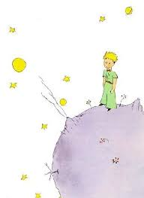
Multimodal texts
Media literacy
WISA workshop, 13-2-2019, Greece
Instructor Zeta Tsigka
zetatsigka@gmail.com

Slide 2
Tell a story to an audience of adults
Tell a story to a kindergarden
Count different types of mods

Slide 3
Modes
Linguistic: vocabulary, structure, grammar of oral/written language
Visual: colour, vectors and viewpoint in still and moving images
Audio: volume, pitch and rhythm of music and sound effects ^
Gestural: movement, facial expression and body language
Spatial: proximity, direction, position of layout, organisation of objects in space.

Slide 4
Hypertext, multimodal text
Are they just new words in our vocabulary?
Or
Important communication skills?

Slide 5
Forms of multimodal texts
paper – such as books, comics, posters.
digital – from slide presentations, e-books, blogs, e-posters, web pages, and social media, through to animation, film and video games.
live – a performance or an event.
and, transmedia–for example, book, comic, magazine, film, web series, and video game mediums all working as part of the same story.

Slide 6
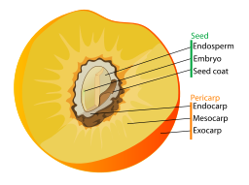
Visual text example

Slide 7
Aims of the scenario ““Travelling with The Little Prince. A multitrip or a hypertrip”
To come into first contact in the sense of hyper-literary literature.
Be aware that the reader in digital media is a co-producer of meaning
Reflect on the idea that the use of digital texts, the web and devices the text is not static and permanent anymore.
It acquires fluidity, requiring the reader's active interaction with it. Each reader selects the hyperlinks he will activate by drawing his own personal path into the text.

Slide 8
-> To reflect on the power of multimedia and interactivity

Slide 9


Slide 10
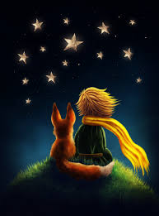

Slide 11
Step 1
Please, read the entry about The Little Prince @ Wikipedia
https://en.wikipedia.org/wiki/The_Little_Prince
And compare with a printed encyclopedia

Slide 12
Step 2
“He began, therefore, by visiting them, in order to add to his knowledge”
Welcome to the planets

Slide 13
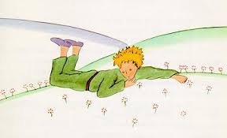

Slide 14


DISCLAIMER:
The European Commission's support for the production of this publication does not constitute an endorsement of the contents, which reflect the views only of the authors, and the Commission cannot be held responsible for any use which may be made of the information contained therein.

