Slide 1
WISA
WISE & INVENTIVE SCREENAGERS

Slide 2
Erasmus+ školní vzdělávání Klíčová akce 2
Výzva 2018 School Exchange Partnerships
Téma projektu: Mediální gramotnost
Číslo projektu: 2018-1-CZ01-KA229-048019
Termín: 1.9.2018 – 31.08.2020 (24 měsíců)

Slide 3
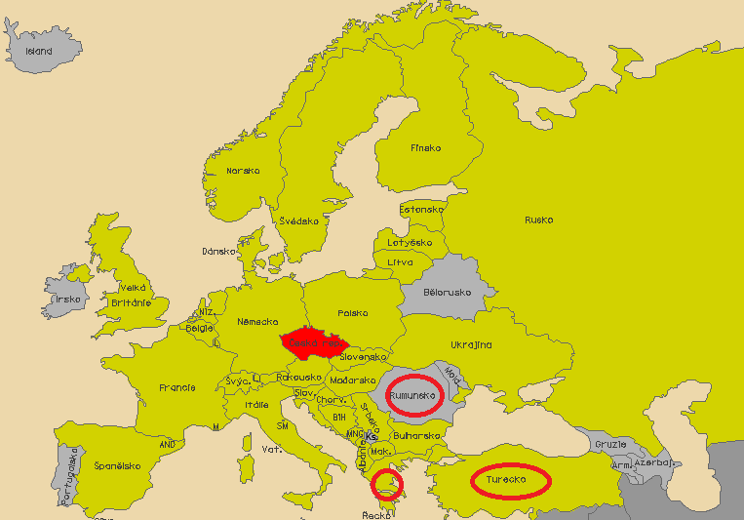

Slide 4
Partnerské školy:
Biskupské gymnázium Brno a mateřská škola (koordinátor), kontaktní osoba: Simoneta Dembická
Tým řízení projektu: Mgr. Karel Mikula (ředitel), Simoneta Dembická, Jiří Vondra, Alena Lojkásková
Projektový tým: Simoneta Dembická + dva studenti (mentoři)
Colegiul Dobrogean "Spiru Haret", Tulcea, Rumunsko, kontaktní osoba: Mihaela Condrat
Gymnaseio Lykeiakes Taxeis Makrychoriou (Highschool), Larissa, Řecko, kontaktní osoba: Georgia (Zeta) Tsigka
Manavgat IMKB Mesleki ve Teknik Anadolu Lisesi, Manavgat, Turecko, kontaktní osoba: Taha Ceyhan

Slide 5
Cíle:
O1-to exchange, share and benefit from good practices in the field of integrating variety of media and Media Literacy Education in the educational process
O2-to create a sustainable media-based and Media literacy enhancing learning environment in our schools by performing media-educational activities both in formal and informal peer-to-peer learning during all project activities and thereafter
O3-to equip students with critical thinking skills in relation with media messages (ability to evaluate, analyze, understand and use media content) in order to become critical and responsible media consumers
O4-to develop students' ability to create and disseminate media content and become responsible media creators
O5-to promote international and intercultural environment in our schools through joint teaching activities that use state-of-the-art ICT tools (such as virtual learning environments, the eTwinning platform and cloud-based collaborative tools)
O6-to create and use innovative and digital assessment methods

Slide 6
Konkrétní, materiální výsledky:
R1-Media Library (open resources for teaching Media Literacy) containing 12 lesson plans covering topics of Media Literacy and Content Creating; and 1 five-day project lessons plan for Media Education that can be incorporated in school curriculum or used as extra-curricular activity
R2-Project YouTube Channel and Vlog
R3-Project website
R4-Screenagers’ Guide to Safe Internet (online guide/brochure with key terms, rules and resources)
R5-Media Literacy Bank-an open educational source containing digital materials (instructional presentations, videos) that can be used in any CLIL lesson or by general public, stakeholders and policy makers
R6-an eTwinning group and eTwinning event
R7-a podcast and articles for school magazines and local newspapers promoting our project

Slide 7
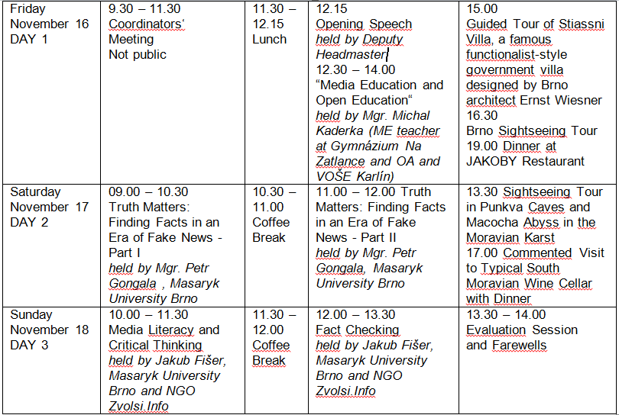
MEZINÁRODNÍ SETKÁNÍ UČITELŮ
16. – 18. 11. 2018 Pracovní setkání učitelů partnerských škol v Brně
PROGRAM:

Slide 8
MEZINÁRODNÍ SETKÁNÍ STUDENTŮ
V průběhu trvání projektu se uskuteční 4 společná mezinárodní setkání. Každého se zúčastní 10 studentů z každé partnerské školy a 2 učitelé jako doprovod.
Studenti budou vybráni ve výběrovém řízení, jehož podmínky a termín budou zveřejněny v dostatečném předstihu před každým výjezdem na stránkách školy. Zúčastnit se mohou všichni studenti vyššího gymnázia.
Za každou školu budou ve zvláštním výběrovém řízení vybráni
2 studenti – mentoři, kteří se zúčastní všech projektových aktivit a všech výjezdů a budou k dispozici i po skončení projektu při přípravě a organizaci projektového týdne. Tito dva studenti by měli být z kvint anebo prvních ročníků, případně sext a druhých ročníků. Výběrové řízení bude zveřejněno na webových stránkách školy koncem listopadu.

Slide 9
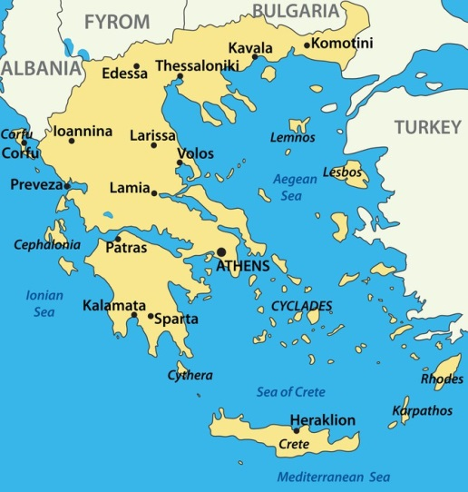
ŘECKO
10. – 16. 2. 2019 10 studentů+2 učitelé
Digital Literacy & Movie-making Lab
Day 1-3. a) Workshop: Media in academic learning and social life
Students in international groups attend interdisciplinary didactic scenarios based on a problem to solve in humanities or physics or ICT. Tutors are
teachers certified in “Pedagogical Incorporation of ICTs in Teaching, National B level” (Ministry of Education, Greece): Content:
-WEB.2.0 tools (wikis, blogs, vlogs, shared files, social media, educational platforms)
-rights, safety, credibleness offered by the Wikimedia User Group Greece.
- b) Outdoors activities
- a treasure hunting game in the town: using mobile devices and relevant applications
-joining a cultural event, keeping diaries for next “digital storytelling” activity
Methodology used: Project Based Learning.
Day 3-5. a) Movie-making Lab: Media in self- expression and social life
Cooperation with specialists (PHD/researchers in the art of cinema, artists, media content creators) and produce different artifacts:
-basics in making a video: from the idea to the movie, writing the script, pre-production, production, post production stage
-technical part of a movie: types of shots, frames, light, colorings, applications for editing, animation
-presentation of students’ short movies productions at the plenary session, feedback
-presentation event at all school students and teachers, parents, members of the community
b) Outdoors activities contain
-traditional Greek cuisine event
-a photo contest
-visit and shots at the historical center of Larissa,
-The Culture day: visit at an UNESCO world heritage monument (the Meteora rocks):
-involvement in the International Film Festival of Larissa: participation in panels, attendance in the session for students’ productions.

Slide 10
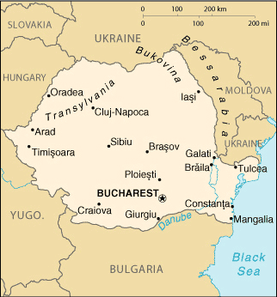
RUMUNSKO
Květen 2019 10 studentů+2 učitelé
Wise Media Consumers and Creators
Day1& 2 Workshop -Title: Wise & Inventive Screen-Agers
Organizers- Romanian teacher &students teamwork presentation&training with the support of national NGO, which is already our school’s educational partner in national project ’’I Teach Media Education”, CJI, or MediaWise Society will be contacted for future partnership
The workshop will approach issues connected with responsible/critical use of different media content and afterwards will proceed to the teenagers’ position of media content contributor.The team will propose presentations, will involve participants in interactive teamwork exercises.
Workshop-Wise media consumer:How we deconstruct a media message?Creative language used in media messages; How do we pop up the filter bubble? - my digital identity, my virtual path.
Workshop- Ingenious media contributor:How do we create a media message?What are the rules I have to respect before posting/sharing?
Learning by doing - writing a short news (students will choose the suitable media channel and while the process of writing will deal with topics like editorial decision, reliable sources, strategies of manipulation.
Day 3 On-the-spot-simulation - The news quest -outdoor activity- working in teams students will visit the city in search for news; they will meet local journalists, interview locals and go back to write/post the news
Day 4 & 5 The Digital Creative Writing Lab- Digital storytelling workshop- introducing Slidestory & ACMI Generator tools ; before mobility, during preparatory activities, the Romanian team will work on creative
writing sessions and say the romanced story of a/some representative place/places(building).Students who are part of our Creative writing Club “Literary Aspirations” will help us write the unknown side of story, give it a unique approach and let our local cultural identity get a special way of
expression.The students from the ICT cLUB will help us to give this romanced story a digital shape and transform it in a good example of digital storytelling.The other teams will be invited in post mobility to work on a similar topic and during the next transnational mobility to compare results.
Video night on day 5 - the videos produced will be broadcasted in the presence of all the teams and local guests (students, parents, journalists).
After mobility- the teams will continue working via the project’s eTwinning platform in order to assess the mobility experience and to equip our Media
Literacy Bank and Screenagers’ Guide to Safe Internet (brochures- key concepts in media literacy; 5 tips to distinguish facts from opinions; 5 key
questions in deconstructing media messages; 10 things to have in mind when watching a video)

Slide 11
ČESKÁ REPUBLIKA
Září 2019 10 studentů+2 učitelé
Fact or Media Fiction
This activity concentrates on propaganda, fake news and disinformation in the media in relation with the rise of populism in politics and
destabilization of democracies. It also focuses on racial, ethnic, cultural and gender stereotypes and cyberbullying.
Day 1 Workshop held by creators of fact-checking platform “Demagog.cz“: basic orientation in the field of media, how to distinguish facts from
disinformation and fake news, how media messages shape our culture and society, use of fact-checking tools.
Fake News Games Afternoon: Introducing the concept of playing Fake News Games as a way to ‘vaccinate’ oneself against disinformation and fake news (based on Roozenbeek, J., & van der Linden, S. (2018).The Fake News Game: Actively Inoculating Against the Risk of Misinformation. Journal of Risk Research. Session of playing online games Bad News, Factitious, Fake It to Make It and BBC iReporter followed by group discussion.
Day 2 Workshop held in cooperation with NGO People In Need or Amnesty International: how to recognize racial, ethnic, gender and cultural stereotypes and hate speech in online space and social media and how to deal with it. (90 minutes, morning session)
Panel discussion with local politicians, journalists, political scientists regarding the topics of propaganda, disinformation and rise of populism as a
threat to democracies, transparency and active citizenship.
Day 3 Workshop on Cyberbullying. Based on watching the trailer to 2015 TV movie Cyberbully or some award-winning short film, followed by group discussion moderated by teachers and psychologists; includes role-playing activities in order to define cyberbullying and its consequences. Tips on online help for victims of bullying, Facebook’s safety tips etc.
Competition on best short video on Cyberbullying. Groupwork: writing screenplays and making 3-minute videos. Broadcasting to public audience
(students, teachers, parents). A jury (project teachers and university art students) and audience vote for the best short film. Awards.
Day 4 Podcasts. Lesson held by IT teachers. Group work: Group 1: Editors. Visit to a local digital radio studio and newsroom; later edit podcast. Groups2,3,4 and 5 work on different tasks creating a podcast promoting our project. Broadcasting in the local radio.
Day 5 Cultural Heritage Day - ‘Brno in stories’ - mixed groups visit cultural heritage sites in Brno and gather material for digital storytelling, which will be made via eTwinning platform as a post-meeting activity.
Methodology: group work, team work, role play, project-based learning, discussion, problem-solving methods
Poznámka: Jedná se o program z žádosti o grant, skutečný program může být pozměnn.

Slide 12
TURECKO
Únor 2019 10 studentů+2 učitelé
Conflict in the Context
Activity 1: Conflict in the Context
Workshop. The goal is to enhance students’ critical thinking and reading skills.
Students will work in groups. They will get news articles on the same topic from different media agencies and they will discuss the texts looking for
signs of different points of view and different purposes and perspectives the agencies have. Each group will chose a speaker and present their ideas.
General discussion will follow.
Activity 2: Power point presentation on Copyrights and Internet Ethics
The hosting students will present powerpoint presentations on digital copyrights and ethics and privacy. After the presentations all participants will be
encouraged to share their views and ideas on the topic. Group discussion.
Activity 3: Dissemination Day
Students will visit municipal authorities and the mayor of Manavgat. Questions for interviews will be already prepared as a preparatory activity by all
partner schools. They will record their intervies, which, after editing, will be offered together with the radio podcast promoting our project (result from
the transnational activity in CR) to local radios.
After that, several groups of students will visit 3 local schools where they will present our project and moderate a discussion about the importance of
Media Literacy with the school students.
Activity 4: Editing Screenagers’ Guide to Safe Internet.
Lesson held by IT teachers: students will learn how to use different graphic programmes.
Afterwards, they will apply a unified design to our project concrete results.
Activity 5: Cultural Heritage Day
Students will attend a Marbling Art Workshop (a traditional Turkish glass painting activity). They will gather video material for digital storytelling
videos that will be made in mixed groups via online platform and posted on project YouTube channel.
Methodology used: group work, team work, project-based learning, learning by doing, problem-solving.
Expected results: enhanced critical thinking skills; unified design of project results, podcast with interviews, dissemination of the project, students’
diaries. Normal activities in host school will not be affected in any disruptive way.

Slide 13
LOKÁLNÍ AKTIVITY
Soutěž o logo projektu do 9. listopadu (prodlouženo do 15.11.)
Podmínky soutěže:
1. Podoba loga se musí vztahovat k tématu mediální gramotnosti.
2. Návrh musí obsahovat slovo WISA (akronym názvu projektu).
3. Maximální počet použitých barev je 5.
4. Návrh nesmí obsahovat fotografii.
5. Návrh musí být vytvořen v některém grafickém programu (např. MS Malování, GIMP apod.) a uložen ve formátu obrázku (např. .png, .jpg apod.).
6. Musí se jednat o originální návrh autora.
Návrhy posílejte jako přílohu na e-mail wisa.medialiteracy@outlook.com (kopii na simoneta.dembicka@gmail.com) s uvedením jména a třídy autora, anebo je přineste na USB flashdisku do kabinetu španělského jazyka č. dveří 161 do 9. (prodlouženo do 15.) listopadu 2018. Vítězné logo vybere mezinárodní porota složená z učitelů všech partnerských škol a bude použito na všech projektových materiálech. Vítěz obdrží diplom a věcnou odměnu a v případě zájmu bude automaticky zařazen do projektových aktivit včetně jednoho z mezinárodních výjezdů.

Slide 14
LOKÁLNÍ AKTIVITY
listopad – prosinec 2018 Students create cultural videos - presentation of each country and their school and post them on project website or upload on Youtube channel. / Introduction to storytelling and digital storytelling
únor 2019 Reflection on Greek meeting, assessment of activities
březen 2019 work on improving/ modifying the video productions of “Movie-making Lab’’
květen 2019 Reflection on the Romania meeting, assessment of activities
/ working on the romance digital storytelling workshop
září – říjen 2019 Reflection on the Czech meeting / creating digital storytelling videos with material gathered in CR and posting them / Preparations of the Guide to Safe Internet
leden 2020 Students prepare questions for interviews with local authorities in Turkey
březen 2020 Digital stories with material gathered in Turkey (about painting on glass) and posting them
Průběžně propagace projektu, diseminační aktivity, eTwinningové společné úkoly…

Slide 15
Díky za pozornost!

